Slide 1
Lexical Elements, Operators and the C System

Slide 2
Tokens
A token is the basic vocabulary of the language.
Tokens in ANSI C
  keywords
  identifiers
  constants
  string constants
  operators
  punctuators
Language syntax specifies the valid combinations of tokens in the language into legal strings.

Slide 3
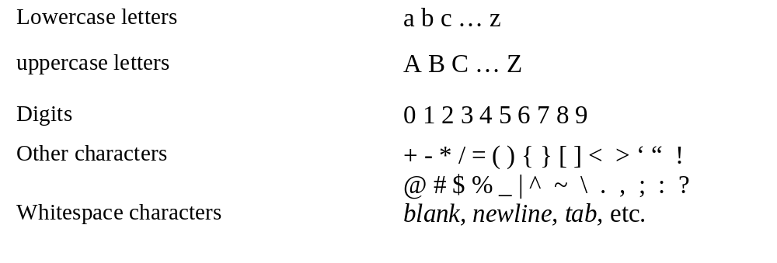
Characters and Lexical Elements

Slide 4
The Sum Program
/* Read in two scores and print their sum. */
#include <stdio.h>
int main(void)
{
int score_1, score_2, sum;
printf(“Input two scores as integers: “);
scanf(“%d%d”, &score_1, &score_2);
sum = score_1 + score_2;
printf(“%d + %d = %d\n”, score_1, score_2, sum);
return 0;
}

Slide 5
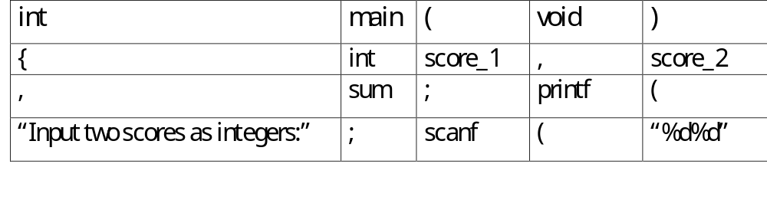
Lexical Discussion of the Sum Program
The compiler replaces a comment with a single whitespace character.
Multiple whitespace characters become single spaces unless they are a string constant.
Any whitespace following commas and semicolons can be removed.
This is how the program looks after the whitespace compression.
  (We will ignore the expansion of <stdio.h> for now…)
  int main(void){int score_1,score_2,sum;printf(“Input two scores as integers: “);scanf(“%d%d”,&score_1,&score_2);sum = score_1+score_2;printf(“%d + %d = %d\n”, score_1, score_2, sum);return 0;}
The compiler will then break this into tokens.

Slide 6
Token types
Identifiers
  main, score_1, score_2, sum, printf, scanf,
Operators
  ( ) + - * %, etc
Keywords
  int, void, return
Punctuators
  , ; {
Comments are not tokens (remember they are removed from the program)

Slide 7
Identifiers
An identifier is a sequence of letters(A-Z, a-z), digits(0-9), and the underscore(_), character. Identifiers may not begin with a digit.
  Usually, identifier names are case sensitive, so Big and big are two different identifiers.
  Good programming style is to choose meaningful names.
  System functions and data areas are often begin with the underscore. You should avoid its use and this way you are unlikely to inadvertently rename a system identifier.
  main is a special identifier. It names the function which will be given control when a program is invoked.

Slide 8
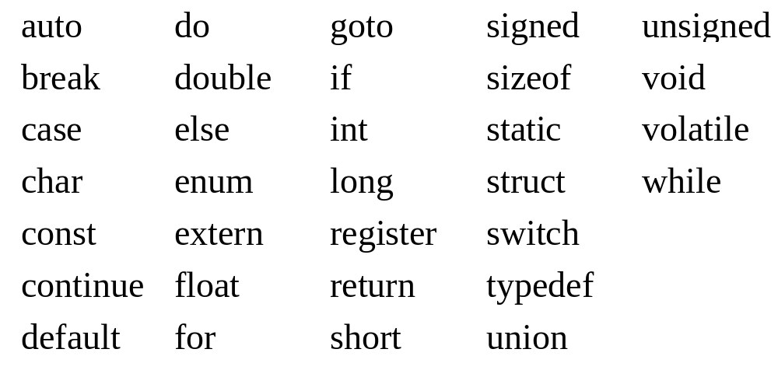
Keywords
Keywords are words (like identifiers) that have a special meaning to the compiler and cannot be used in your programs for other purposes.

Slide 9
Constants
The value of a constant is given at COMPILE time, and (of course) cannot be changed.
integer constants
  3, 9, -4
floating point constants
  1.3, 1.97, -43.21
character constants
  ‘a’, ‘+’, ‘\n’, ‘\’
character string constants
  “ This is a character string containing a doublequote (\”)”
enumeration constants
  constant values for user defined types. We will see these later.

Slide 10
Operators and Punctuators
Arithmetic Operators
  + - * / %
    Remember, a %b is the remainder when a is divided by b, but inside a control string % begins a format
Punctuators
  { , ; ( ) }
  except the parenthesis after the name of a function (like main() ) is an operator….
Multi-character operators
  += -= *= /= %=
    a += b; means the same as a = a + b;
    Whitespace is not allowed between the + and the =
  ++, --
    a++; means the same as a = a+1;

Slide 11
Precedence of Operators
Precedence tells us the order to apply operators.
  e.g. 1+2*3 could mean
    add 2 to 1 and multiply the result by 3 with result of 9
    add 1 to the result of multiplying 2 and 3 with result of 7
In C, multiplication and division have precedence over addition and subtraction.
  1+2*3 will have the value 7 because the multiplication PRECEEDS the addition.
You can use parenthesis to override the precedence of operators.
  (1+2)*3 has value 9, since the expression in parenthesis is evaluated first

Slide 12
Associativity of Operators
The binary operators + and - have the same precedence, so do * and /.
How is 1 + 2 - 3 *4 evaluated.
  Since * has higher precedence than + and -, 3 * 4 is evaluated first, so this is equivalent to 1 + 2 - (3 * 4)
  Binary operations with the same precedence are performed from the left to the right. This is an example of an associativity rule. It simply states the order in which to associate the operands and operators. Thus our expression is the same as (1+2) - (3 * 4)
When in doubt you can use parenthesis.

Slide 13
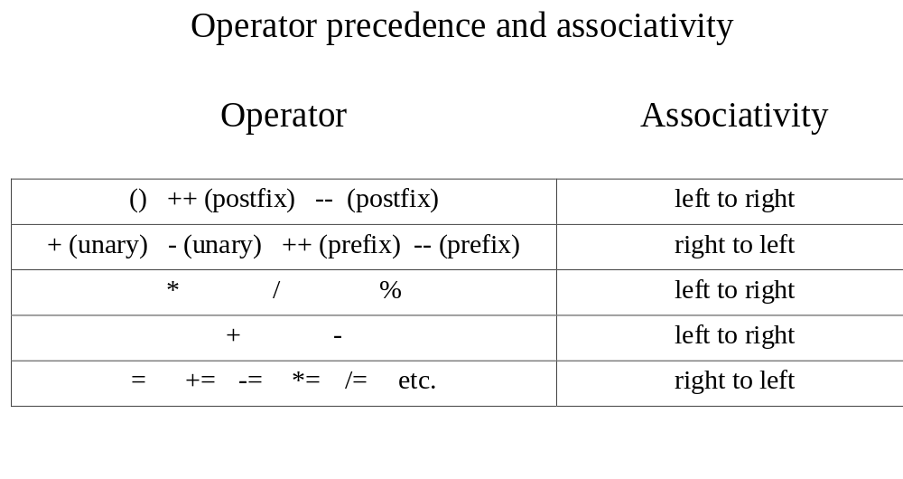
Order precedence and associativity

Slide 14
Increment and Decrement Operators
++i means increment (add one to) the current value of the variable i. i++ also means to increment the value of variable i. These operations have a side effect, i.e.they change the value of an operand.
  The expressions ++i (prefix increment) and i++ (postfix increment) both cause the variable i to be incremented. However, the expressions have different values. When you write ++i, the increment occurs before the expression is evaluated. When you write i++, i is incremented after the expression is evaluated.
If you are writing a statement to increment i, the prefix operator is preferred.

Slide 15
Example of Prefix and Postfix Binary Operations
int a, b, c = 0; /* a,b are NOT initialized */
a = ++ c;
b = c++;
printf(“%d %d %d\n”, a, b, ++c); /* 1 1 3 is printed */
int b = 2, d = 4;
printf(“%d\n”, 7 - - b * ++d); /* 17 is printed */

Slide 16
Assignment Operators
In C, each expression has a value. The expression a = b+c has the value b+c. This is valid code in C language.
int a, b, c;
b = 2; /* These are assignment statements. They */
c = 3; /* end with a semicolon */
a = b + c; /* a has value 5 after execution. */
but so is:
int a, b, c;
a = (b = 2) + (c = 3); /* here = is an operator since no semicolon */
/* and after execution a=5, b=2, c=3 */

Slide 17
Example: Computing Powers of Two
/* Some powers of two are printed. */
#include <stdio.h>
int main(void)
{
int exponent = 0, power_of_two = 1;
while (++exponent <= 10)
printf(“%5d”, power_of_two *= 2);
printf(“\n”);
return 0;
}

Slide 18
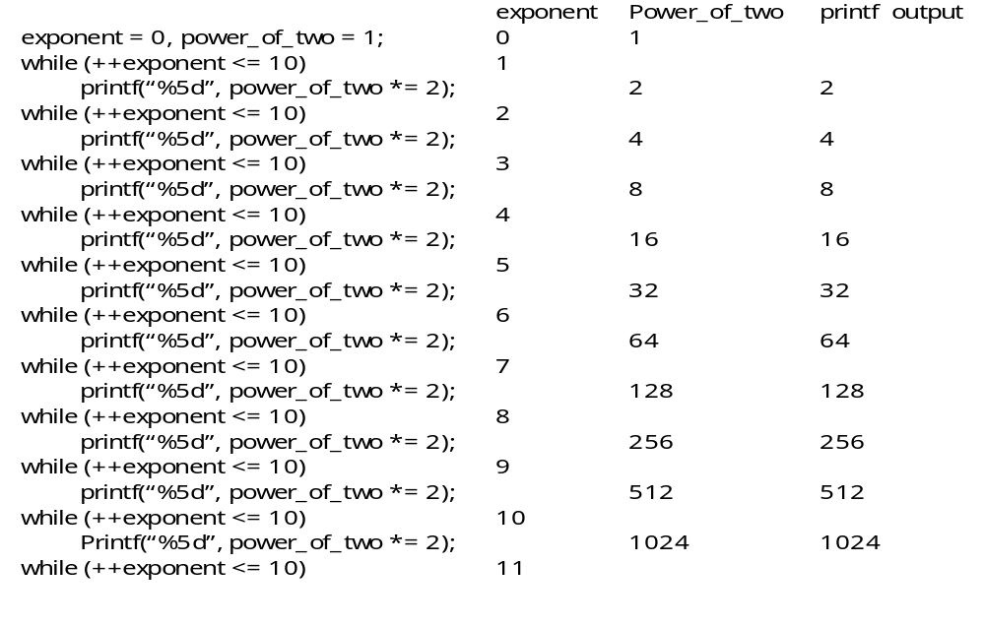
Trace of Powers of Two Program

Slide 19
The C System
C System includes:
  preprocessor
  compiler
  library
  also editors and debuggers

Slide 20
Preprocessor
Preprocessing directives are lines beginning with the # symbol --- almost always this is in column 1
We have seen
  #include <filename> and #define PI 3.14.159
Another form of #include
  #include “filename” looks first in current directory and then in system dependent places for filename.
#include is used to bring in pre-defined identifiers, function prototypes and typedefs.
  stdio.h has more than 600 lines of code and is hard to read.

Slide 21
Function prototypes
Function prototypes tell the compiler about a function that you may call.
  It tells the number and type of arguments that are passed to the function and the data type of the value the function returns.
e.g. suppose a function named square which multiplies the floating point argument by itself and returns the result in a double. It’s prototype would be:
  double square(float arg1) ;
stdio.h contains the prototypes for printf and scanf.
math.h contains prototypes for mathematical functions.

Slide 22
Standard Library
The standard library contains the object code for a wide variety of commonly used functions.
  printf() and scanf() are in the standard library.
Examples of other standard library functions:
  int isalpha(int c); /* is c an alpha character */
  int tolower(int c); /* lowercases c */
  double sin(double x); /* sine of angle x */
  double pow(x, double y); /* x to the yth power. */
  int open(char *filename); /* opens a file. */
  int close(int fd); /* closes an open file */
  int read(int fd, char *buf, int n); /* reads n bytes into buf */
  int write(int fd, char *buf, int n); /* writes n bytes */

Slide 23
For loops
The for loop is a control structure like the while loop. The general form of the for loop is :
    for (expr1; expr2; expr3)
    statement
    next statement
The for loop will execute as if we had written the following lines of code:
  expr1;
  while (expr2) {
  statement
  expr3;
  }
  next statement;

Slide 24
How to think of a for loop
for (i=0; i<n; ++i) {
STUFF
}
This is a classic example of a for loop. The programmer wants to have the stuff between the braces executed n times. Note the use of the prefix increment operator. Would it make a difference if you used the postfix operator? If you aren’t sure write a simple program with the pair of loops:
for (i=0; i<n; i++){
printf(“%d\n,i);
}
for (i=0; i<n; ++i){
printf(“%d\n,i);
}

Slide 25
The if statment
The general form of the if statement is:
  if (expr)
  statement
expr is evaluated. If it is non-zero(true), then statement is executed. Otherwise statement is skipped.

Slide 26
A (nasty) example of an if statement
if (i % 6 == 0)
printf(“%d is evenly divisible by 6\n”, i);
Ok, we know that the printf() function will be called if the STUFF inside the parenthesis evaluates to non-zero. But how do we evaluate (i % 6 == 0). The double equal signs, ==, are the equality operator. This operator has the value 1 if the thing on the left has the same value as the thing on the right. But do we evaluate this as if it were written
( ( I % 6 )== 0 ) or as ( i % ( 6 == 0 ) ). The % operator has higher precedence than the equality operator, so ( ( i % 6 )==0) is the correct interpretation.
Now % is the remainder(modulo) operation. It will return the remainder when the value of variable i is divided by 6. This will be 0 only when i= 0, 6, 12, etc. When this happens the remainder will equal 0, and thus ( i% 6) will have the value 0. Thus the left hand side of the equality operator will equal the right hand side, so the equality operator will evaluate to 1.
The above if statement will print out when i=0, i=6, ...

Slide 27
Standard Library Random Numbers
/* Printing random numbers. */
#include <stdio.h>
#include <stdlib.h>
int main(void)
{
int i, n;
printf(“\n%s\n%s”,”Some randomly distributed integers will be printed.”,
“How many do you want to see? “);
scanf(“%d”, &n);
for ( i = 0; i < n; ++i) {
if ( i % 6 == 0 )
printf(“\n”);
printf(“%9d”, rand());
}
printf(“\n”);
return 0;
}

Slide 28
Notes on the Prn_rand program
#include <stdlib.h>
The rand() function has its function prototype in the stdlib.h include file
The rand() function returns a random number its actual prototype is:
int rand();
Notice how the nesting conveys the intent of the programmer. Remember the compiler ignores spacing, if you nest beautifully but don’t match your braces correctly the results will be BAD.
for (i=0; i<n; ++i) {
if (i % 6 == 0)
printf(“\n”);
printf(“%9d”, rand());
}

Slide 29
Style: Lead Comments
It is a good habit to always begin your programs with a block of comments that describe the purpose of the program. In professional programs, the programmer and/or organization that created the program will be named. The date the program was first written will be included. In addition, if the program undergoes revisions (yours won’t in this class), a history is normally kept by adding a line after the opening block for each revision.

Slide 30
Example of Opening commentary
/*****************************************/
/* Organization: XYZ systems inc. */
/* Programmer: John Doe */
/* Original Release Date: December 25, 1990 */
/* */
/* Purpose: A simple day of the week routine */
/* Revision History: */
/* Year 2000 bug fix on Dec 23, 1999 */
/*****************************************/

Slide 31
Chapter 2 Review
Tokens in ANSI C are keywords, identifiers, constants, string constants, operators, and punctuators.
Operators act on the values of identifiers.
The operations within an expression are performed in the order specified by the rules of precedence. If operators have equal precedence, they are associated according to their associativity rules. The associations usually are from left to right but not always.
Keywords are words that are reserved in the language and cannot be used to name identifiers. One should also avoid naming identifiers with the names of standard library functions.
Side effects are changes that happen in addition to the evaluation of an expression. Incrementing and decrementing are examples of side effects.
We have had our first glimpse of while, for, and if statements. These are examples of control flow statements.

Slide 32
Example 11.
Study the following code and write down what you think it prints. Then write a test program to check your answers.
int a, b =0, c = 0;
a = ++b + ++c;
printf(“%d %d %d\n”, a, b, c);
a = b++ + c++;
printf(“%d %d %d\n”, a, b, c);
a = ++b + c++;
printf(“%d %d %d\n”, a, b, c);
a = b-- + c--;
printf(“%d %d %d\n”, a, b, c);
The program prints out
2 1 1
2 2 2
5 3 3
5 2 2

Slide 33
Example 13
/* Declarations and Initializations */
int a=2, b = -3, c = 5, d = -7, e = 11, f = -3;
printf(“a / b / c = %d\n”, a / b / c);
printf(“7 + c * -- d / e = %d\n”, 7 + c * -- d / e);
printf(“2 * a % - b + c + 1 = %d\n”, 2 * a % - b + c + 1);
printf(“39 / - ++ e - + 29 %% c = %d\n”, 39 / - ++ e - + 29 % c);
printf(“a += b += c += 1 + 2 = %d\n”, a += b += c += 1 + 2 );
Answers are: 0, 4, 7, -7, 7
What is wrong with
7 - + ++ a % (3 + f)
Hint: What does 3 + f evaluate to?

